Slide 1

PYTHON PROJECT
ROCK PAPER SCISSORS

Slide 2

INTRODUCTION
Rock, Paper, Scissors – the timeless and universally recognized game that transcends language and culture.
Despite its simplicity, Rock, Paper, Scissors has become a symbol of decision-making and chance, offering a playful way to resolve dilemmas.

Slide 3


This classic hand game, often used to make decisions or settle disputes, pits three basic elements against each other -
Rock crushes Scissors,
Scissors cuts Paper,
Paper covers Rock.

Slide 4

WINNING RULES
In the Rock, Paper, Scissors game, each of the three elements – Rock, Paper, and Scissors – can defeat one of the others while being defeated by the third. Here are the winning rules:
Rock crushes Scissors:
Rock wins against Scissors as it symbolizes the force or power to crush.
Scissors cuts Paper:
Scissors wins against Paper as it represents the cutting action.
Paper covers Rock:
Paper wins against Rock as it can cover or wrap around the rock.

Slide 5


Slide 6

STEPS TO BE FOLLOWED TO IMPLEMENT THE GAME
PLAN THE STRUCTURE
IMPORT NECESSARY MODULES
DEFINE LIST OF CHOICES
GET USER’S CHOICE
GENERATE COMPUTER’S CHOICE

Slide 7
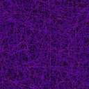


Slide 8
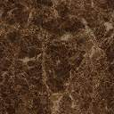
CALCULATION OF SCORES
PRINT RESUTS
DETERMINE THE WINNER
PLAY AGAIN OPTION
TESTING
DEPLOY THE PROJECT

Slide 9
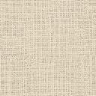


Slide 10


